Slide 1
Epilepsy
Dr Muhammad Ashraf
Assistant Professor Medicine

Slide 2
Objectives
Classify epilepsy and describe the epidemiology of epilepsy
Enlist the risk factors of epilepsy
Identify provoked and unprovoked seizure
Enlist the causes of epilepsy
Define status epilepticus

Slide 3
Epilepsy (sometimes referred to as a seizure disorder) is a common chronic neurological condition that is characterized by recurrent unprovoked epileptic seizures.
It affects approximately 50 million people worldwide.
It is usually controlled, but not cured

Slide 4
DEFINITION
A chronic disorder characterized by paroxysmal brain dysfunction due to excessive neuronal discharge, and usually associated with some alteration of consciousness.
The clinical manifestations of the attack may vary from complex abnormalities of behavior including generalized or focal convulsions to momentary spells of impaired consciousness.

Slide 5
Epidemiology
The most common ages of incidence are under the age of 18 and over the age of 65. It has been estimated that about 1% of the population meets the diagnostic criteria for epilepsy at any given time, but some theorize that the prevalence may be much higher in fact.

Slide 6
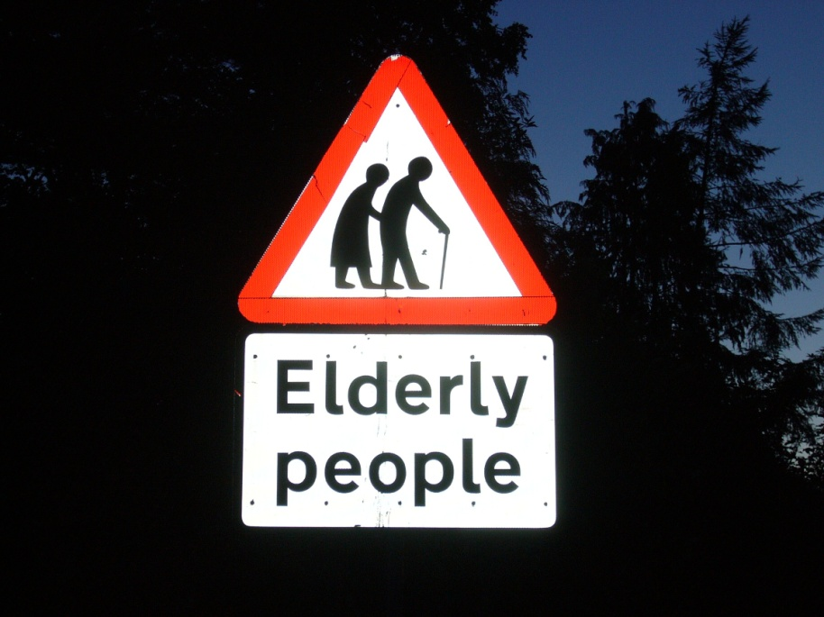
Epidemiology and course
Epilepsy usually presents in childhood or adolescence but may occur for the first time at any age.
Newborns
Early school age
Adolescents
Seniors

Slide 7
Epidemiology and course
5% of the population suffer a single sz at some time
0.5-1% of the population have recurrent sz = EPILEPSY
70% = well controlled with drugs (prolonged remissions)
30% epilepsy at least partially resistant to drug treatments = INTRACTABLE (PHARMACORESISTANT) EPILEPSY.

Slide 8
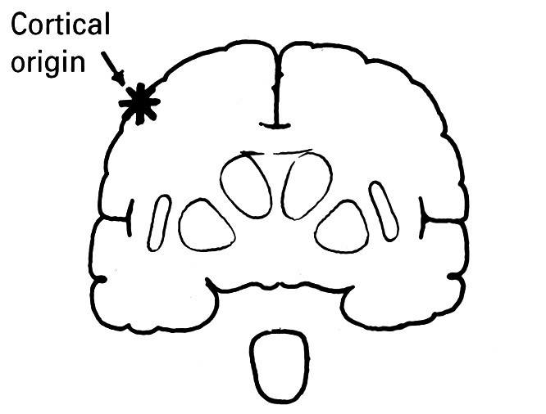
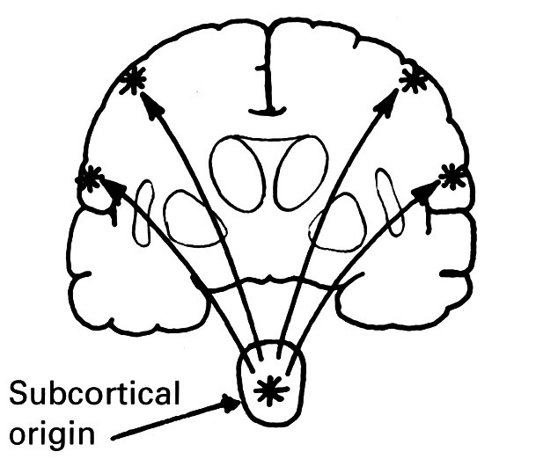
Epilepsy - Classification
Focal seizures – account for 80% of adult epilepsies
Simple partial seizures
Complex partial seizures
Partial seizures secondarilly generalised
Generalised seizures
Unclassified seizures

Slide 9
Generalized seizures
(convulsive or non-convulsive)
Absences
Myoclonic seizures
Clonic seizures
Tonic seizures
Atonic seizures

Slide 10
TONIC-CLONIC SEIZURES
ABSENCE SEIZURES
ATONIC SEIZURE
MYCLONIC SEIZURES
SIMPLE PARTIAL SEIZURES
COMPLEX PARTIAL SEIZURES

Slide 11
Risk factors
Babies who are small for their gestational age
Babies who have seizures in the first month of life
Babies who are born with abnormal brain structures
Bleeding into the brain
Abnormal blood vessels in the brain
Serious brain injury or lack of oxygen to the brain

Slide 12
Risk factors Cont,n
Brain tumors
Infections of the brain: abscess, meningitis, or encephalitis
Stroke resulting from blockage of arteries
Family history of epilepsy
Fever-related (febrile) seizures that are unusually long
Use of illegal drugs such as cocaine

Slide 13
Provoked & Unprovoked Seizure
Many definitions of epilepsy require that the seizures be unprovoked, with the implication that the provocant is assumed to be something obviously harmful.
Examples of these normal provocants include reading, hot water on the head, hyperventilation and flashing or flickering lights.
This last provocant is a special type of reflex epilepsy called photosensitive epilepsy.

Slide 14
Certain circumstances can lead to an increased likelihood of seizures in someone with epilepsy or in certain syndromes.
For example: During sleep The transition between sleep and awake ,Tiredness, Illness, Constipation, Menstruation Stress

Slide 15

Etiology-Causes
Identifiable Causes of Epilepsy in Children:
Brain injury to the fetus during pregnancy
Birth trauma –lack of oxygen
Head trauma, e.g., car accident
Brain tumor and stroke
Infection e.g., meningitis
Poisoning from substance abuse or environmental contaminants, e.g., lead poisoning.

Slide 16
Status Epilepticus
A condition when consciousness does not return between seizures for more than 30 min.
This state may be life-threatening with the development of pyrexia, deepening coma and circullatory collapse. Death occurs in 5-10%.

Slide 17
THANK YOU

