Slide 1

Transforming e-learning
Michael Grahame Moore
Distinguished Professor of Education
The Pennsylvania State University
U.S.A.
Editor:
The American Journal of Distance Education
mgmoore@psu.edu

Slide 2
“To transform e-learning into engaging performance-driven learning experiences”
Key words:
“transforming” : how can e-learning be improved?
“engaging” : how to transform the experience of students and the environments in which they learn ?
“performance driven”: how to transform teaching so it is more effective and “engaging” ?
Transforming learning and teaching requires transformations in educational institutions
Transforming institutions requires transformation in policies governing the allocation of resources

Slide 3

Transforming e-learning: the context
information age
knowledge based society
post-modern society
driven by digital technologies

Slide 4
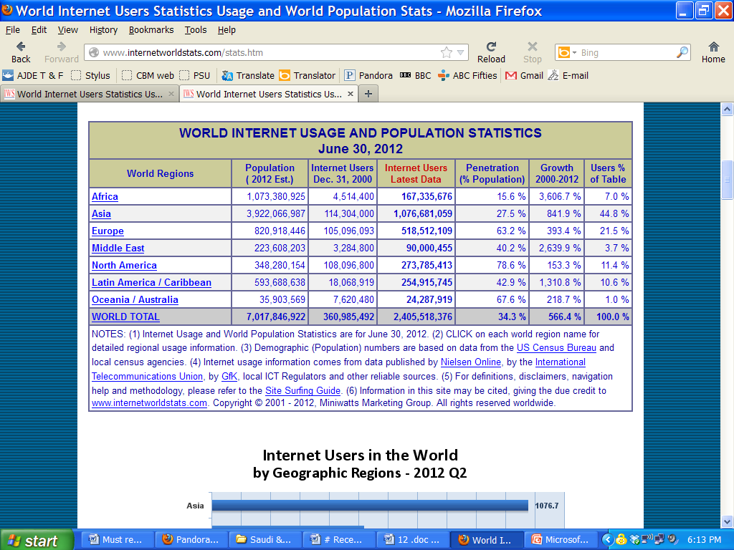
http://www.internetworldstats.com/stats5.htm#me

Slide 5
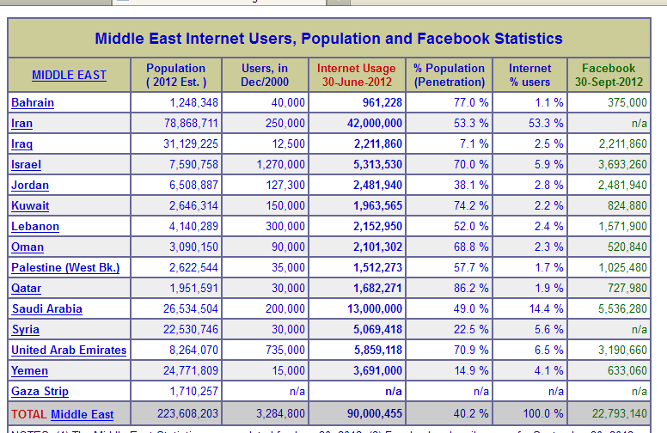
http://www.internetworldstats.com/stats5.htm#me

Slide 6














“engaging technologies”
user or locally
generated
open access
Interactive
social
user managed

Slide 7


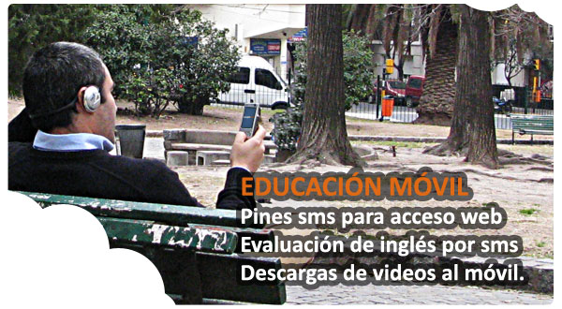
“engaging” technologies
E-learning to M-Learning
in the cloud
2010: 7.5 billion devices
2015: 15.0 billion devices
80% Internet by mobiles
(Cisco)

Slide 8
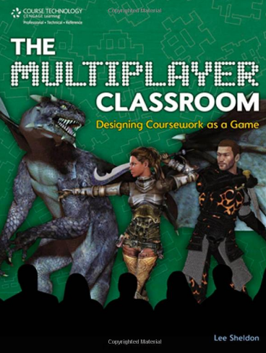
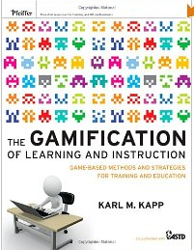
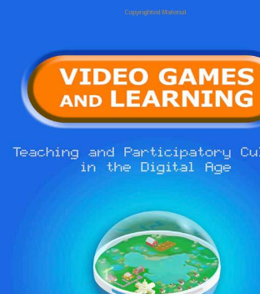
engaging technologies: gaming

Slide 9

Engaging technologies
Learning Analytics and Adaptive learning
analysis of each student’s prior experience,
performance,
strengths and weaknesses,
point to prescribed content tailored to that student.
data about prior learning captured from learning management system including time spent on a resource, frequency of posting, and number of logins.
Heavy investment by for-profit test preparation
companies Grockit and Knewton

Slide 10


Engaging technologies: summary
Old technology New technology
Analog Digital
Generic Personal
Information delivery Information exchange
Expert driven User driven
Uni-directional Networked
Closed Open
Static Mobile
Predictable Adaptable
Limited availability Widespread

Slide 11

How is e-learning to be transformed?
Transforming views of learning and learners
Transforming roles of teachers
Transforming role of course designers
Transforming institutions

Slide 12

Transforming views of learning (1)
“Engaged” learning is (a) personal and also (b) social
(a) Personal:
engaged learners generate knowledge from within, not by absorbing information from outside
engaged learners make meaning out of their own experiences
engaged learning requires reflection
and meta-cognition
immediate outcomes of a engaged learning
experiences are varied and often unpredictable

Slide 13

Transforming views of learning (2)
(b) Engaged learning is social:
-- values knowledge distributed across a community
--- values shared inquiry
-- values learning based on experience (real or simulated)
-- values non-linear as well as traditional forms of expression
-- encourages co-design of experiences
An engaged learning community:
-- has diversity of expertise among its members
-- expects and values contributions from all
--- has mechanisms for sharing what is learned
-- common objective to advance collective knowledge
-- shared emphasis on learning how to learn

Slide 14

searching, sorting, sifting
and evaluating
multi-tasking
synthesizing
communicating
reflecting
immersion
Transforming views of learners
engaged learners need new skills:

Slide 15
Transforming the role of teacher
From performer to conductor –
of engaging learning environments !
facilitating students’ searching – individually and
collaboratively
linking and weaving ideas and information created by students, summarizing, pulling together the threads, managing and sifting information
relating the particular experience to general theory
monitor each student’s performance against expected standards and intervene when needed

Slide 16
Transforming the role of the teacher: FOCUS ON PERFORMANCE
Engaging learning – personal, social, open, flexible, interactive -- increased risk of student (and also instructors) becoming lost
Therefore success depends on clarity and agreement about expected results -- observable and measurable -- in student performance
did each student’s performance indicate having learned what was required and if not, why not?
Observable performance requires a product – an assignment
Focus on assignment is motivating for student and instructor
Interaction is only a means towards performance objective
Importance of continuous monitoring (formative evaluation)
Data reported from monitoring provides feedback for improvement of system and for instructor training

Slide 17
Transforming e-learning : the institutional challenge
The structure of universities has not changed to keep pace with
e-learning technology
The classroom is not the appropriate model for e-learning.
It is no longer viable for an individual to be equally expert in subject matter, technology management, course design, evaluation, facilitating group interaction and individualization of learning
It is no longer viable for an institution to be equally expert and competitive in every subject-matter, relevant technology, course design, evaluation and teaching
Transforming e-learning requires specialization of individuals and institutions, with each focused on its comparative advantage and extending to a potential national or global population
This means re-organizing resources in and between institutions

Slide 18

Traditional Policy
Transforming Policy
Faculty and staff establishments will :
provide teams that cut across vertical divisions for specific projects and
allow for redeployment to reflect changing needs
Funds will be allocated:
for the heavy front-end investment in designing technology based learning
for amortisation of costs over the lifetimes of programs -- usually more than 12 months
Faculty and staff establishments are:
based on permanent positions, vertical divisions and hierarchical relationships
Funds are allocated:
for line items in a budget fixed for specified periods, usually 12 months
(based on RSA Telematics initiative)

Slide 19
Transforming organizational systems
Strategic alliances
Virtual systems
Independent study – MOOCS and badges

Slide 20
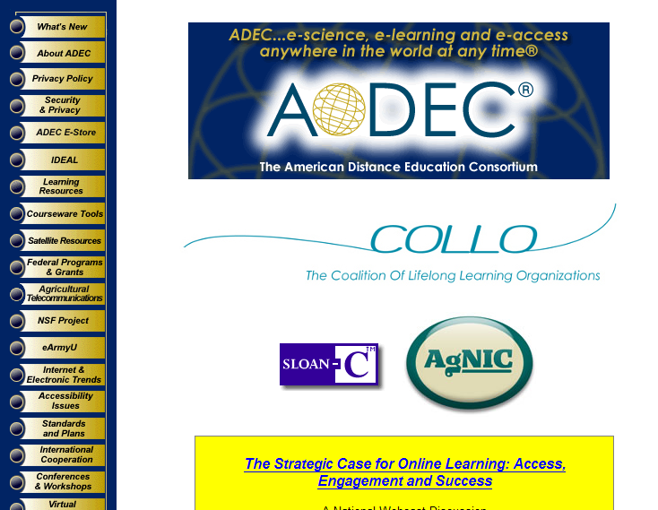
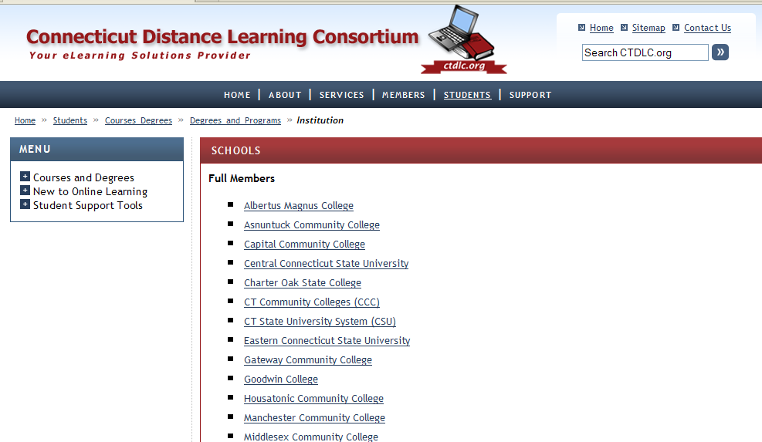
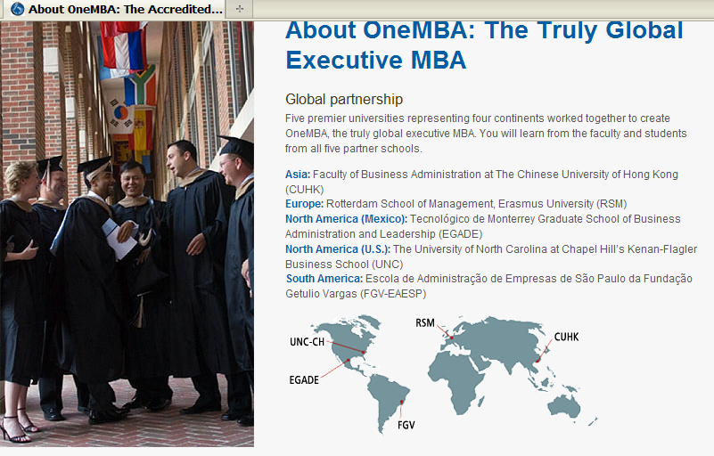
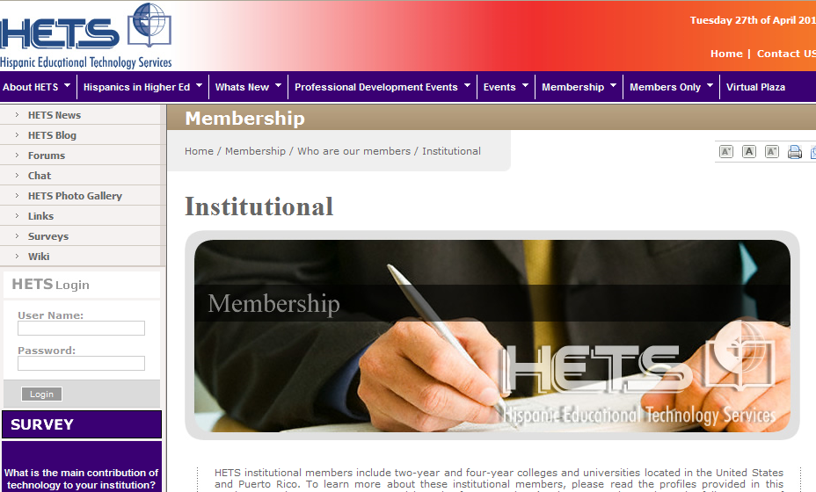
Strategic Alliances in USA states EXAMPLES
Connecticut Distance Learning Consortium
American Distance Education Consortium
Hispanic Educational Technology Services
One MBA

Slide 21










What is Semester Online?
“ Semester Online is a consortium of top colleges and universities. It is the first program of its kind to offer undergraduate students the opportunity to take rigorous, online courses for credit from some of the country’s leading universities.
Semester Online is a for-credit, online program for undergraduates offering rigorous courses, where students will have access to renowned professors from multiple, highly selective institutions.
Courses are taught live, in small groups where students are surrounded by outstanding peers and guided by renowned professors – much as they would be if they were on campus.
Compelling, richly produced, self-paced course materials are designed with university faculty and are accessible 24 hours a day.
Familiar social networking tools allow students to connect and build relationships with peers from their school and other schools online.”

Slide 22
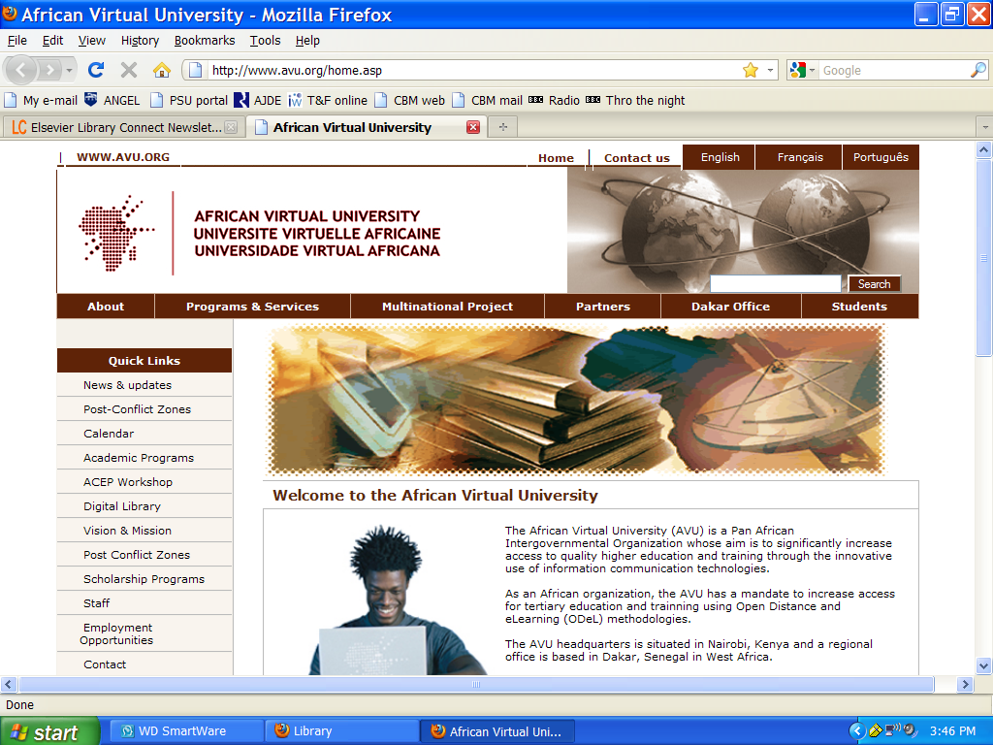
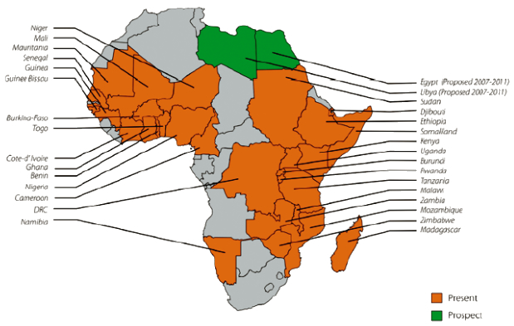
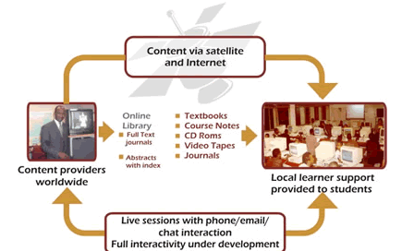
The AVU collaborating partners include:
African Ministries of Education
African Union
Association of African Universities
UNESCO IIEP
UNESCO BREDA
UNESCO Teacher Training Program in Sub-Saharan Africa
Association of Universities and Colleges of Canada
Open University of UK- TESSA
Universite� Laval Canada
University of Ottawa Canada
Memorial University of Newfoundland
Curtin University Australia
Indiana University in Pennsylvania, USA
Maestro, Washington DC, USA
International Development and Research Centre, Canada
Partnership for Higher Education in Africa
MIT Open Courseware
Merlot African Network
South African Institute for Distance Learning
Commonwealth of Learning
Global Text Project
Strategic Alliances: African Virtual University

Slide 23
A new model: virtual systems
A system that designs and delivers learning programs by commissioning the component processes and services from all available agencies.
The general principle is that a state or nation - can draw on the best resources wherever they are located to build a network of
— content experts, instructional designers, communications technologies, group facilitators and a learner support system
— and configure whatever mixture is needed for a particular program or project on a flexible, open, "mix and match" basis.

Slide 24

An example of virtual system:
PROFORMACAO Brazil’s teacher education program
The Brazil problem
72,522 rural primary schoolteachers needing training
Solution:
National coordinating group to recruit and manage teams of specialists in subjects, instructional design, pedagogy, technologies
To design courses for delivery at home and school
Supported by local tutors
Trained by state-level teacher-educators
With performance measured by regular assignments
Monitored at state and central levels
with training interventions when needed at state/local or national levels

Slide 25
Virtual system Brazil
Funder
Management team
National advisory ctee
Course design teams
Production & distribution team
UNIVERSITY 1
UNIVERSITY 2
UNIVERSITY 3
Platform
video company 1, 2
Publisher 1,2,
Software 1,2
Study center
State coordinators
S
T
U
D
E
N
T
S
tutors
Study center
State monitoring and training teams
tutors
State UNIVERSITY 1
State UNIVERSITY 2
State UNIVERSITY 3
Study center
tutors
tutors
Study center
Municipal teacher 1 Municipal teacher 2 Etc

Slide 26
Conditions for success
Technology: advanced at central and regional levels, simple at village level
Design: Strictly performance centered
world class content, software, instructional design specialists
Delivery system: integrated design, learner support, training and tutorial system with weekly performance monitoring and data reporting
Financial : large investment with low average costs due to economies of scale
Political : national leadership, state and local agreements

Slide 27
A New, Demand-Driven Model of E-learning : Independent Learning
“consumer,” (the learner), not the “supplier” – university, or other provider - decides what is to be learned, when, where, how, or to what extent.
Faculty not limited to any one place (or virtual institution)
Students learn wherever they are located from teachers and instructional resources wherever they are located
from any institution or country at any time and in any combination
Recent manifestation: MOOCS (Massive online open Courses), free e-learning offered by major institutions, not part of a degree or other structure. Learners can mix with other experiences into a personal portfolio of achievement (performance).
Examples:
Stanford University -- 160,000 students in 190 countries in a course on Artificial Intelligence
Massachusetts Institute of Technology : course materials online accessed by 100 million people in 2,000 courses
Udemy: private for-profit site for experts to teach and anyone to learn.

Slide 28

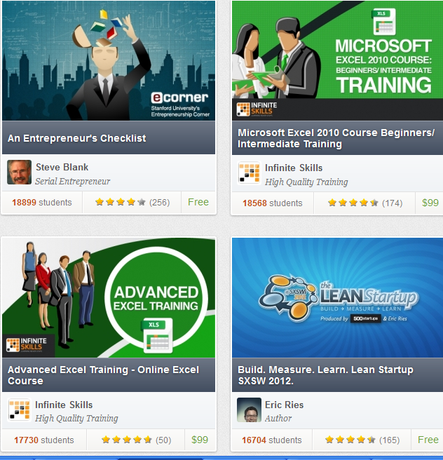

Slide 29
Breaking the institutional monopoly of certification.
educational institutions have monopoly over the supply of teaching by controlling certification – that monopoly is under threat from “badge” movement.
Mozilla Open Badge Infrastructure (OBI)
A badge is a certification of what a student knows
Open Badges Infrastructure will let students gather such badges from any site on the internet, combining them into a porfolio regardless of where they learned.
The Mozilla Foundation with funding support from the MacArthur Foundation to develop the Open Badges Infrastructure,
aiming to provide the basic building blocks for any organization to offer badges in a standard, interoperable manner.
Mozilla is currently developing its own badges for things like Javas cript course,
but other groups are contemplating developing digital badges
including NASA and the US Department of Education.
https://wiki.mozilla.org/Badges/infrastructure-tech-docs

Slide 30
Performance in the news.
Wisconsin’s Governor Walker:
"We’re going to tie our funding in our technical colleges
and our University of Wisconsin System into performance
and say if you want money, we need you to perform,
and particularly in higher education,
we need you to perform not just in how many people you have in the classroom
that means not only degrees,
but are young people getting degrees in jobs that are open and needed today,
not just the jobs that the universities want to give us,
or degrees that people want to give us?"
Source: http://host.madison.com/

Slide 31

How much is engaging learning and performance centered teaching implemented in your institution ?
What transformations are needed?
What is your opinion of John Dewey’s 1916 prediction?
‘A society which is mobile, which is full of channels for the distribution of a change occurring anywhere, must see to it that its members are educated to personal initiative and
adaptability.
Otherwise, they will be overwhelmed
by the changes in which they are caught
and whose significance or connections
they do not perceive.’
Concluding questions

Slide 32


Thank you for your attention
Comments? Questions?
mgmoore@psu.edu
www.routledge.com/u/HBofDistanceEdu3e
Available November 2012 | 640 pages | Paperback: 978-0-415-89770-9

