Slide 1
Searching Medical Content on OvidSP
KSMC 2011

Slide 2
Why Ovid is critical now and in the future.
There are numerous studies that have outlined the significant impact of having clinically relevant information available, the positive impact of clinical outcomes and the quality of patient care.
We have selected a number of such studies for you:
Notes:
First of all, I’d like to be quite clear: Our Inbox must be our main task and respond to Customer as soon and efficient as possible our aim.
Having said that, I’m also looking forward to include an added value for Ovid Technical Support, that “something else” that will make the difference between Ovid and our competitors.
I’d work hard to accomplish a nice team-mate environment, with people enthusiastic and proud of their jobs, trying to avoid any grouping or separatism that may affect any member of the team or the job of the whole department.
It’s important to be more Sales focussed, the ex-change of information in both ways between Sales Reps and Tech Support shall lead us to accomplish Ovid’s goal and the level of Service that is expected from us.

Slide 3
Clinical Decision Reports
Article 1-
Addressing information requirements for doctors and residents
Conclusion:
Studies have repeatedly shown that clinicians have significant informational needs that are not met in their practices. Researchers estimate that although one clinical question arises per patient visit, as many as 70% of these questions go unanswered.

Slide 4
The Benefits of Having Online Medical Information Available at the Point-of-Care
Article 2
Case studies of how accessing information was critical to patient care decisions
Conclusion (1 case example):
During the repair procedure [elibrary content] was searched using the terms “mitral regurgitation”and “Perimount.” Reassurance was obtained by review of the publication by Firstenberg et al., (7) which stated that mild central regurgitation in this valve immediately postoperatively was a benign finding.

Slide 5
Value of hospital libraries: the Fuld Campus study
Article 3
Demonstrating the value of a Health Science Library from one that was considering cutting content
Conclusion:
Results of this study substantiated previous research showing that health sciences LIS contributes to patient health care. Feedback also demonstrated other areas where LIS contributes to the mission and goals of the organization and how these align themselves with Abels et al.’s taxonomy.

Slide 6
Does online content help experienced doctors answer clinical questions?
Artcle 4
A study showing the correlation between clinician performance and having information VS. not having it
Conclusion:
System use resulted in 21% improvement in clinician’s answers.

Slide 7
Do studies show libraries improve patient care?
Document 5
Myths and truths about library services
Conclusion:
Research has shown that libraries improve patient care

Slide 8
The impact of the hospital library on clinical decision making
Document 6
The Rochester study on the impact of the hospital library on clinical decision making
Conclusion:
The Rochester study asked whether the information provided by the library saved the physician time, and 84.7% agreed that this was the case. As a result of the information received from the library, 80% of the physicians indicated that they probably (48.0%) or definitely (32.4%) handled some aspect of the clinical situation differently than they would have handled it otherwise.

Slide 9
Types of Content

Slide 10
Journals – What to Look For
Quality content
Current content
As much available content as possible
Cost effective solutions
Efficient methods of search

Slide 11
Why Databases@Ovid?
Content
More than 100 core and niche databases—from MEDLINE®, PsycINFO®, and Embase® to AMED, HaPI, and Maternity and Infant Care
Archive access: BIOSIS Archive, CAB Abstracts Archive, Embase Classic, Global Health Archive, Inspec Archive, Zoological Record Archive
Features
Customizable links to all available full-text holdings. Easily integrate your Databases@Ovid resources with your institution’s Ovid and non-Ovid bibliographic and full-text content
Saved searches delivered via RSS feed or AutoAlert email
Ovid Jumpstarts—email “shortcuts” that take users directly into a specific point in a database

Slide 12
Why Journals@Ovid? LWW Total Access
Quality Content
Seemless access to 280 premier journals, essential to any medical institution
Many journals are “official” titles of prestigious societies and associations
Current Content
No journals in the collection are under any embargoes
Get access to critical content from selected journals before they are available in print
As much available content as possible
A la carte journals can be added to refine your collection at any time. Choose from hundreds of titles
Cost effective solutions
Total Access offers reduced savings vs. the purchase of individual titles
Efficient methods of search
OvidSP

Slide 13
Why Books@Ovid?
Content
More than 3,000 current, online textbook editions from the world’s most prestigious scholarly publishers, including one of the largest selections of core clinical ebooks.
Resources from Lippincott Williams & Wilkins, Oxford University Press, Clinical Publishing, Jones and Bartlett, John Wiley, Springer Science+Business Media, and other major publishers
Flexible Solutions
Subscription or purchase
Collections
A la carte

Slide 14
Value Beyond Content: OvidSP
OvidSP
“One Search Query”
Journals Books Databases
One Set of Results

Slide 15
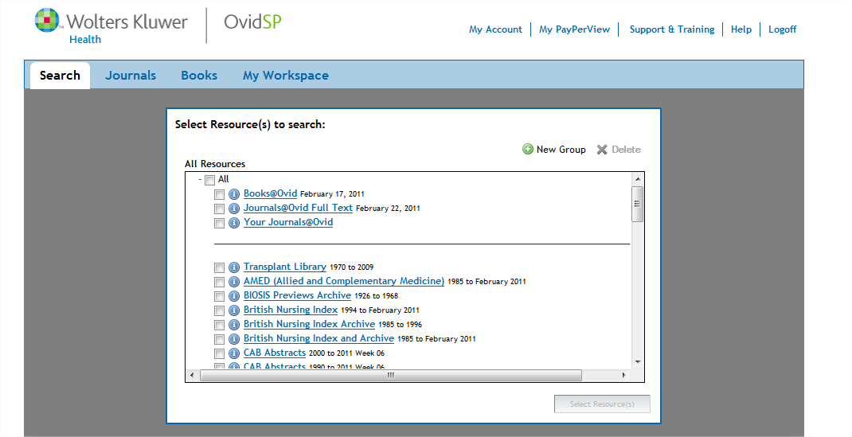
Getting started is easy!

Slide 16
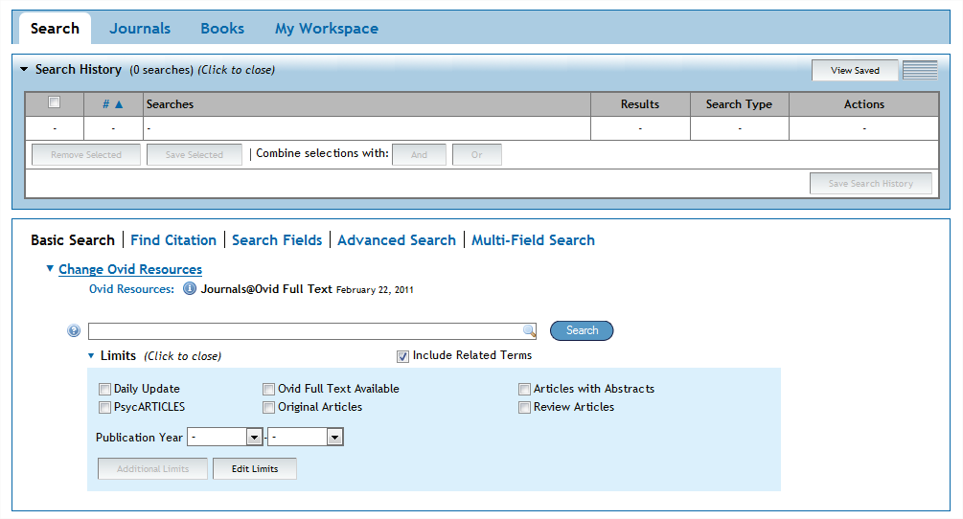
Intuitive Search Interface

Slide 17
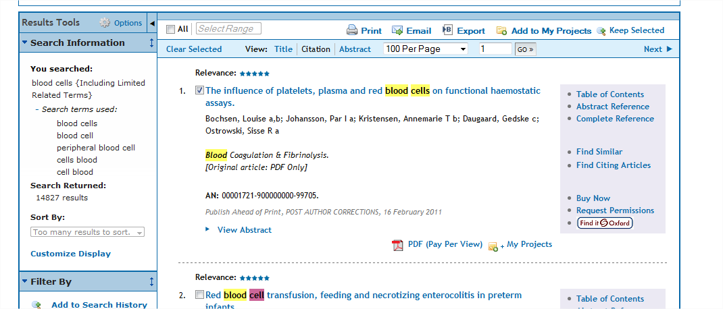
Convenient Search Management

Slide 18
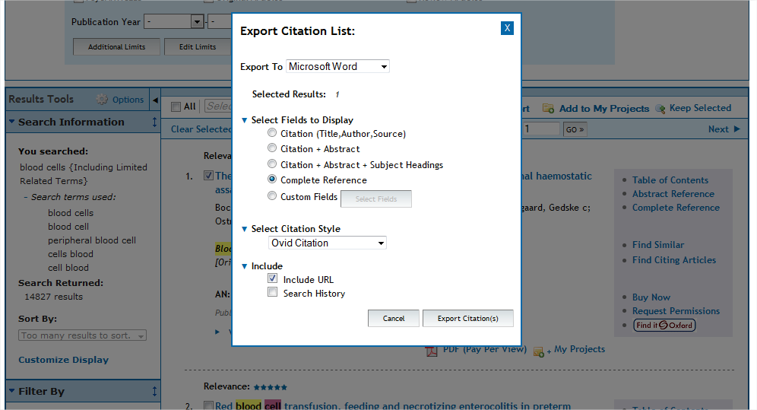
Powerful Result Management

Slide 19
OvidSP: Additional Features Just a few examples…
Multiple search refinement methods
Linksolver
eTocs
Email and RSS alerts
Expert search

