Slide 1
Physiological Regulation of Arterial Blood Pressure
Dr Khwaja Amir
Assistant Professor

Slide 2
Objectives
By the end of this session, the student should be able to:
Outline the different mechanisms involved in regulation of ABP.
Discuss the role of reflexes especially baroreceptor reflex in regulation of ABP.
Discuss the role of renin-angiotensin system in regulation of ABP.
Discuss the role of renal-body fluid in long-term regulation of ABP.

Slide 3
Mechanisms Involved for Regulation of Arterial Blood Pressure

Slide 4
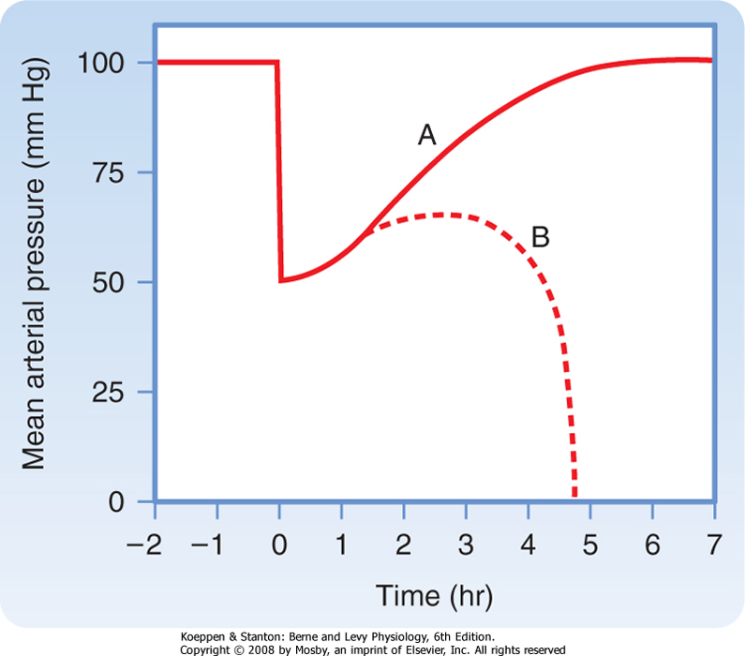
Changes in mean arterial pressure after rapid hemorrhage
A-return of MAP to normal by compensatory mechanism
B-failure of compensatory mechanism leading to hypovolemic shock and death

Slide 5
Mechanisms Involved for Regulation of Arterial Blood Pressure
Rapidly acting mechanism for regulation of blood pressure
Mostly the nervous control mechanism
Baro receptor feed back mechanism
Central nervous system ischemic mechanism
Chemoreceptor mechanism
Intermediate acting mechanism for control of blood pressure
Renin angiotensin vasoconstrictor mechanism
Stress relaxation of vasculature
Fluid shift across the capillary for adjustment of blood volume
Long term mechanism for control of blood pressure
Renal blood volume pressure control mechanism

Slide 6
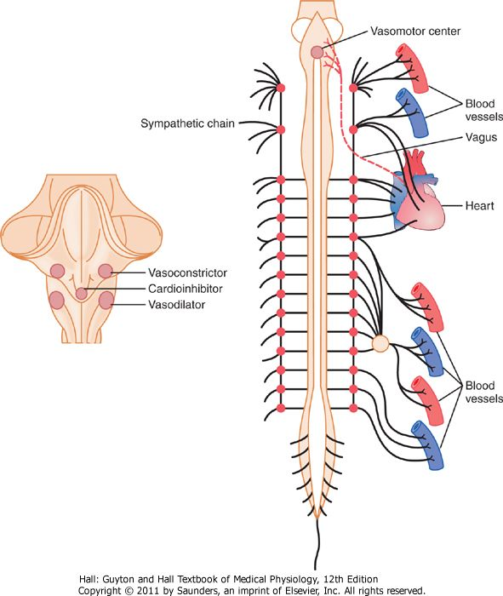
Sympathetic nervous control of circulation

Slide 7
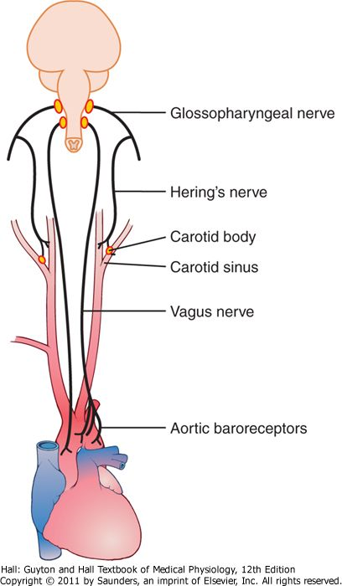
The baroreceptor system for controlling arterial pressure

Slide 8
Role of the Nervous System in Rapid Control of Arterial Pressure
Nervous control of arterial pressure is by far the most rapid of all our mechanisms for pressure control.
When there is drop in arterial blood pressure there are three major changes that occur simultaneously, each of which helps to increase arterial pressure. They are as follows
Most arterioles of the systemic circulation are constricted.
The veins especially (but the other large vessels of the circulation as well) are strongly constricted. This displaces blood out of the large peripheral blood vessels toward the heart, thus increasing the volume of blood in the heart chambers.
Finally, the heart itself is directly stimulated by the autonomic nervous system, further enhancing cardiac pumping.

Slide 9
Reflex Mechanisms for Maintaining Normal Arterial Pressure

Slide 10
Reflex Mechanisms for Maintaining Normal Arterial Pressure
Baroreceptor reflex
It is the baroreceptor arterial pressure control system and it is the best known nervous mechanism for control of arterial pressure.
Basically, this reflex is initiated by stretch receptors, called either baroreceptors or pressoreceptors, located at specific points in the walls of several large systemic arteries.
Baroreceptors are spray-type nerve endings that lie in the walls of the arteries; they are stimulated when stretched. They are extremely abundant in (1) the wall of each internal carotid artery slightly above the carotid bifurcation, an area known as the carotid sinus, and (2) the wall of the aortic arch, the aortic sinus.

Slide 11
The baroreceptors respond much more to a rapidly changing pressure than to a stationary pressure.
Carotid sinus <Hering’s nerve<Glossopharyngeal nerve<NTS in the medulla; Aortic sinus < vagus nerve< NTS in medulla
Excitation of the baroreceptors by high pressure in the arteries reflexly causes the arterial pressure to decrease because of both a decrease in peripheral resistance and a decrease in cardiac output. Conversely, low pressure has opposite effects, reflexly causing the pressure to rise back toward normal.
Function of the Baroreceptors -During Changes in Body Posture
Because the baroreceptor system opposes either increases or decreases in arterial pressure, it is called a pressure buffer system and the nerves from the baroreceptors are called buffer nerves.
The long-term regulation of mean arterial pressure by the baroreceptors requires interaction with additional systems, principally the renal-body fluid-pressure control system (along with its associated nervous and hormonal mechanisms).

Slide 12
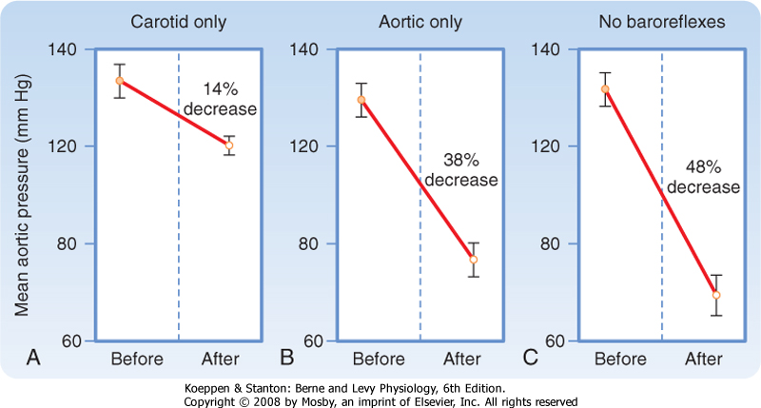
Changes in mean aortic pressure in response to 8% blood loss in three groups of individual (2)

Slide 13
Control of Arterial Pressure by the Carotid and Aortic Chemoreceptors-chemoreceptor reflex
Whenever the arterial pressure falls below a critical level, the chemoreceptors become stimulated because diminished blood flow causes decreased oxygen, as well as excess buildup of carbon dioxide and hydrogen ions that are not removed by the slowly flowing blood. The signals transmitted from the chemoreceptors excite the vasomotor center, and this elevates the arterial pressure back toward normal.
However, this chemoreceptor reflex is not a powerful arterial pressure controller until the arterial pressure falls below 80 mm Hg. Therefore, it is at the lower pressures that this reflex becomes important to help prevent further decreases in arterial pressure

Slide 14
Atrial and Pulmonary Artery Reflexes Regulate Arterial Pressure
Both the atria and the pulmonary arteries have in their walls stretch receptors called low-pressure receptors
These low-pressure receptors play an important role, especially in minimizing arterial pressure changes in response to changes in blood volume
They do detect simultaneous increases in pressure in the low-pressure areas of the circulation caused by increase in volume, and they elicit reflexes parallel to the baroreceptor reflexes to make the total reflex system more potent for control of arterial pressure

Slide 15
Atrial Reflexes That Activate the Kidneys-The "Volume Reflex."
Stretch of the atria also causes significant reflex dilation of the afferent arterioles in the kidneys. Signals are also transmitted simultaneously from the atria to the hypothalamus to decrease secretion of antidiuretic hormone (ADH). Combination of these two effects-increase in glomerular filtration and decrease in reabsorption of the fluid-increases fluid loss by the kidneys and reduces an increased blood volume back toward normal
Atrial stretch caused by increased blood volume also elicits a hormonal effect on the kidneys-release of atrial natriuretic peptide-that adds still further to the excretion of fluid in the urine and return of blood volume toward normal

Slide 16
Atrial Reflex Control of Heart Rate (the Bainbridge Reflex)
An increase in atrial pressure also causes an increase in heart rate, sometimes increasing the heart rate as much as 75 percent
The stretch receptors of the atria that elicit the Bainbridge reflex transmit their afferent signals through the vagus nerves to the medulla of the brain. Then efferent signals are transmitted back through vagal and sympathetic nerves to increase heart rate and strength of heart contraction. Thus, this reflex helps prevent damming of blood in the veins, atria, and pulmonary circulation
Central Nervous System Ischemic Response
This arterial pressure elevation in response to cerebral ischemia is known as the central nervous system (CNS) ischemic response. It is one of the most powerful of all the activators of the sympathetic vasoconstrictor system

Slide 17
The Renin-Angiotensin System: Its Role in Arterial Pressure Control

Slide 18
Components of the Renin-Angiotensin System
Renin is synthesized and stored in an inactive form called prorenin in the juxtaglomerular cells (JG cells) of the kidneys.
The JG cells are modified smooth muscle cells located in the walls of the afferent arterioles immediately proximal to the glomeruli.
When the arterial pressure falls, intrinsic reactions in the kidneys themselves cause many of the prorenin molecules in the JG cells to split and release renin.
Most of the renin enters the renal blood and then passes out of the kidneys to circulate throughout the entire body

Slide 19
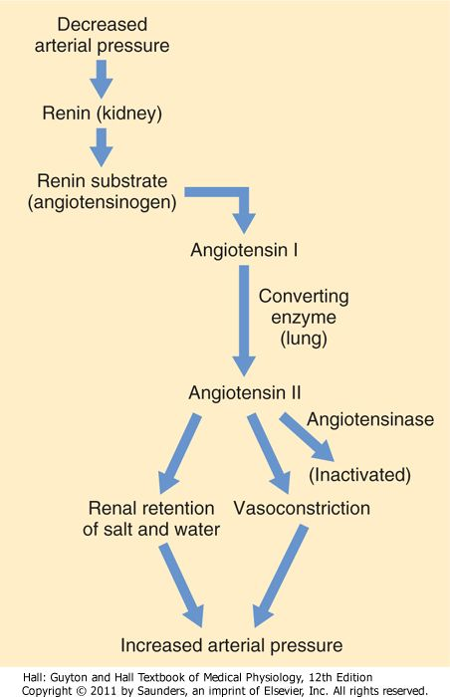
Renin-angiotensin vasoconstrictor mechanism for arterial pressure control

Slide 20
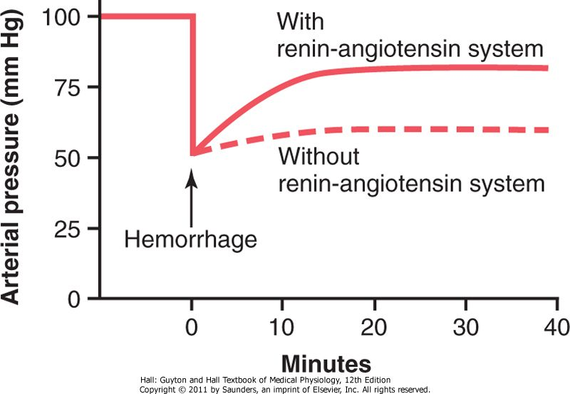

Slide 21
Angiotensin II is an extremely powerful vasoconstrictor, and it also affects circulatory function in other ways as well.
During its persistence in the blood, angiotensin II has two principal effects that can elevate arterial pressure.
The first of these, vasoconstriction in many areas of the body, occurs rapidly. Vasoconstriction occurs intensely in the arterioles and much less so in the veins. Constriction of the arterioles increases the total peripheral resistance, thereby raising the arterial pressure.
The second principal means by which angiotensin II increases the arterial pressure is to decrease excretion of both salt and water by the kidneys. This long-term effect, acting through the extracellular fluid volume mechanism, is even more powerful than the acute vasoconstrictor mechanism in eventually raising the arterial pressure.

Slide 22
Angiotensin II causes the kidneys to retain both salt and water in two major ways:
Angiotensin II acts directly on the kidneys to cause salt and water retention.
Angiotensin II causes the adrenal glands to secrete aldosterone, and the aldosterone in turn increases salt and water reabsorption by the kidney tubules.
Thus both the direct effect of angiotensin on the kidney and its effect acting through aldosterone are important in long-term arterial pressure control. However, research has suggested that the direct effect of angiotensin on the kidneys is perhaps three or more times as potent as the indirect effect acting through aldosterone-even though the indirect effect is the one most widely known.

Slide 23
Stress Relaxation ofVasculature

Slide 24
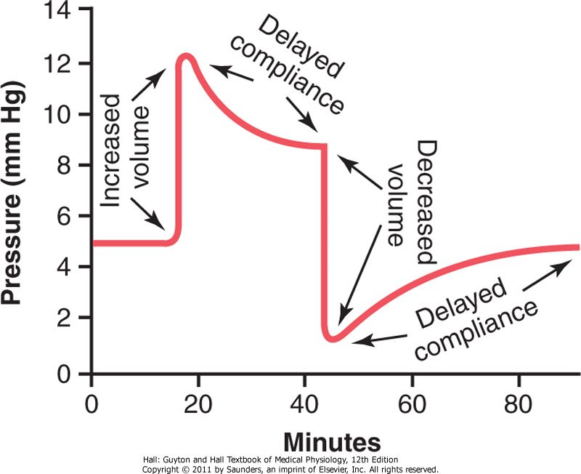
Delayed Compliance in a Venous Segment

Slide 25
Delayed compliance (Stress relaxation) of vessels
The principle of delayed compliance is the mechanism by which a blood vessels attempts to return back to its original pressure when it is loaded with blood or blood is withdrawn from it , this is a property of smooth muscles and is exhibited by blood vessels as well as hollow viscera like urinary bladder
When a segment of a vein is exposed to increased volume , then immediately its pressure increases but after some time the pressure returns back to normal due to stretching of the vessel wall, similarly after drop in original volume due to any fluid loss the blood pressure decreases for some time and then it returns back to normal due to changes in the arrangement of smooth muscle. Similar phenomenon can be seen in urinary bladder.

Slide 26
Fluid shift across the capillary for adjustment of blood volume

Slide 27
The arterial hypotension, arteriolar constriction, and reduced venous pressure during hemorrhagic hypotension lower hydrostatic pressure in the capillaries. The balance of these forces promotes the net reabsorption of interstitial fluid into the vascular compartment
Considerable quantities of fluid may thus be drawn into the circulation during hemorrhage. About 0.25 mL of fluid per minute per kilogram of body weight may be reabsorbed by the capillaries. Thus, approximately 1 L of fluid per hour might be autoinfused from the interstitial spaces into the circulatory system of an average individual after acute blood loss
Substantial quantities of fluid may shift slowly from the intracellular to the extracellular space. This fluid exchange is probably mediated by secretion of cortisol from the adrenal cortex in response to hemorrhage. Cortisol appears to be essential for the full restoration of plasma volume after hemorrhage

Slide 28
Role of renal-body fluid control mechanism in long-term regulation of ABP

Slide 29
An increase in arterial pressure in the human of only a few mm Hg can double renal output of water, which is called pressure diuresis, as well as double the output of salt, which is called pressure natriuresis.

Slide 30
Control of renal NaCl and water excretion
Renal Sympathetic Nerves (↑ Activity: ↓ NaCl Excretion)
↓GFR
↑ Renin secretion
↑ Na⁺ reabsorption along the nephron
Renin-Angiotensin-Aldosterone (↑ Secretion: ↓ NaCl Excretion)
↑ Angiotensin II stimulates reabsorption of Na⁺ along the nephron
↑ Aldosterone stimulates Na⁺ reabsorption in the thick ascending limb of Henle's loop, distal tubule, and collecting duct
↑ Angiotensin II stimulates secretion of ADH
Natriuretic Peptides: ANP, BNP, and Urodilatin (↑ Secretion: ↑ NaCl Excretion)
↑ GFR
↓ Renin secretion
↓ Aldosterone secretion (indirect via ↓ in angiotensin II and direct on the adrenal gland)
↓ NaCl and water reabsorption by the collecting duct
↓ ADH secretion and inhibition of ADH action on the distal tubule and collecting duct
ADH (↑ Secretion: ↓ H₂O Excretion)
↑ H₂O reabsorption by the distal tubule and collecting duct

Slide 31
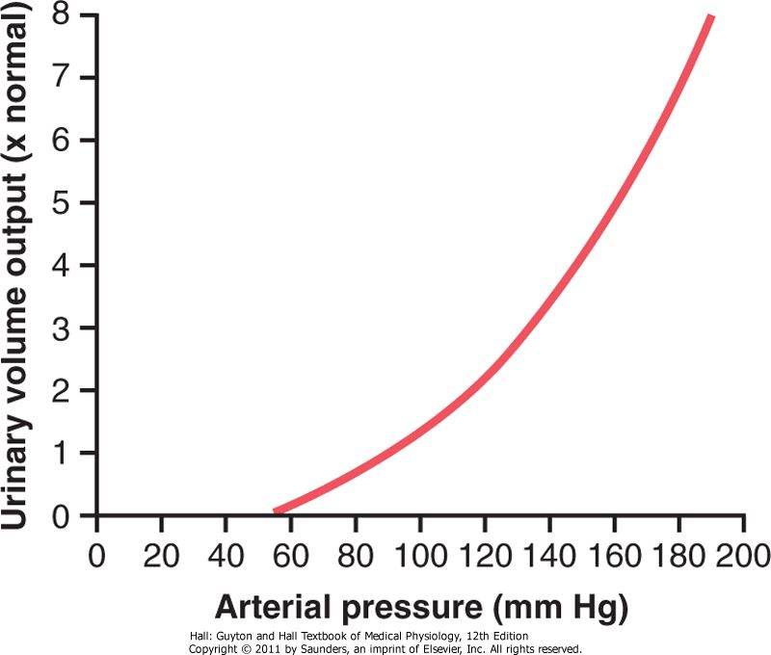
Renal Urinary Output Curve
The approximate average effect of different arterial pressure levels on urinary volume output by an isolated kidney, demonstrating markedly increased urine volume output as the pressure rises. This increased urinary output is the phenomenon of pressure diuresis.
Not only does increasing the arterial pressure increase urine volume output, but it causes approximately equal increase in sodium output, which is the phenomenon of pressure natriuresis.

Slide 32
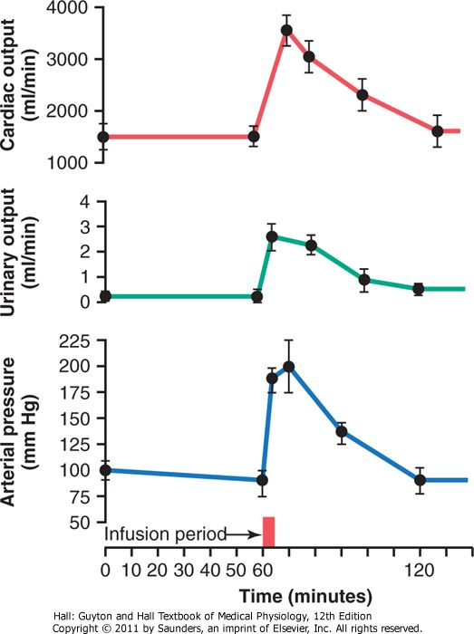
Increases in cardiac output, urinary output, and arterial pressure caused by increased blood volume in dogs whose nervous pressure control mechanisms had been blocked. This figure shows return of arterial pressure to normal after about an hour of fluid loss into the urine

Slide 33
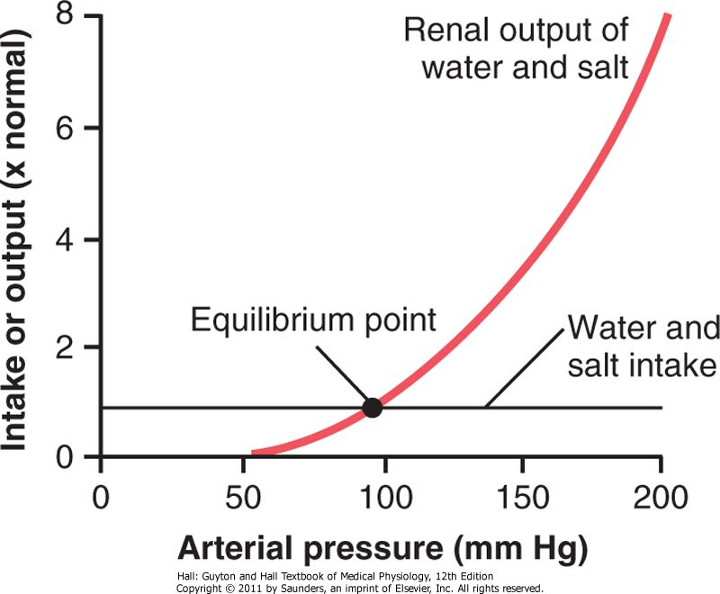
Near infinite feedback gain
This return of the arterial pressure always back to the equilibrium point is the near infinite feedback gain principle for control of arterial pressure by the renal-body fluid mechanism.

Slide 34
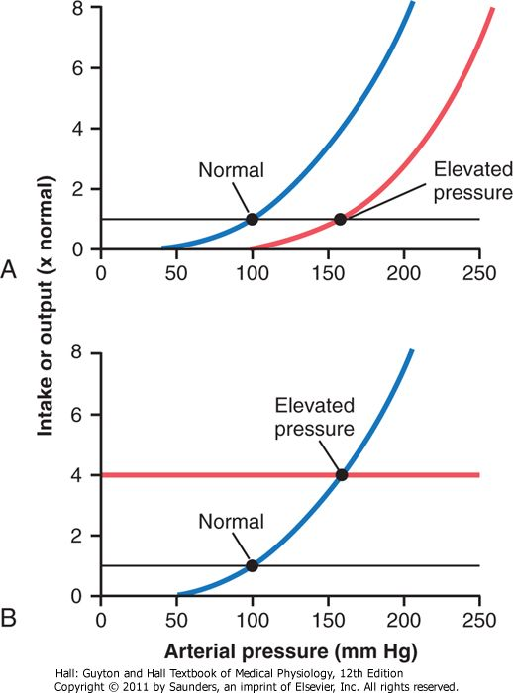
Two ways in which the arterial pressure can be increased:
A, by shifting the renal output curve in the right-hand direction toward a higher pressure level or
B, by increasing the intake level of salt and water

Slide 35
Summary
Outline the different mechanisms involved in regulation of ABP.
Discuss the role of reflexes especially baroreceptor reflex in regulation of ABP.
Discuss the role of renin-angiotensin system in regulation of ABP.
Discuss the role of renal-body fluid in long-term regulation of ABP.

Slide 36
thanks

