Slide 1
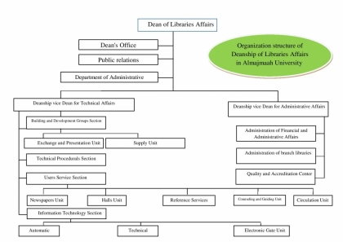
Organization structure of Deanship of Libraries Affairs in Almajmaah University

