Slide 1
Myeloproliferative Disorders (Neoplasm)II
Dr. Ibrahim. A. Adam

Slide 2
Objectives
Discuss definition, types, pathophysiology, clinical features, laboratory findings, complications and treatment of essential thrombocythsaemia
Discuss definition, pathophysiology, clinical features , laboratory findings , complications and treatment of myelofibrosis

Slide 3
Introduction

Slide 4
Essential Thrombocythemia (ET)
Marked increase in megakaryocytes & platelet mass
Predisposition to thrombotic and hemorrhagic events
Generally indolent course
Transformation to acute leukemia uncommon, but occurs

Slide 5
ET: Epidemiology
Uncommon, but not very rare
Predominantly older population
Men ~ women:
Frequent occurrence in young women described in some series

Slide 6
ET: Clinical Manifestations
Many patients are asymptomatic
Major clinical manifestations usually related to thrombosis
May have bleeding (less common)

Slide 7
ET: Thrombosis
Arterial > venous
Small vessels (arterioles) >> large vessels
Any system in body can be affected
Neurologic & distal extremities most commonly involved
Headache
Paresthesias
Transient ischemic attacks:

Slide 8
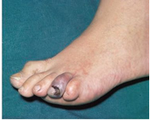
ET: Thrombosis

Slide 9
ET: Thrombotic Manifestations
Partial correlation between platelet count & thrombotic manifestations:
Higher count associated with higher risk
Risk factors for thrombosis:
- Older age (>60 years)
- History of previous thrombotic disease
- Smoking
Young patients with no other risk factors or previous history of thrombotic episodes have relatively low risk of thrombotic events

Slide 10
ET: Hemorrhagic Manifestations
Tends to occur with high platelet counts (>10⁶ platelets/mL)
Bleeding is generally mild
GI tract most common site of bleeding
Other sites: skin, eyes, urinary tract, gums, joints, brain

Slide 11
ET: Differential Diagnosis
Reactive thrombocytosis
Other chronic myeloproliferative neoplasms
Pseudothrombocythemia:
WBC fragments (leukemia), schistocytes, microspherocytes (severe thalassemia)
Must exclude chronic myeloid leukemia (CML)!

Slide 12
Causes of Reactive Thrombocytosis
Infections
Inflammation of any type
Malignancy (non-hematologic)
Trauma
Blood loss or iron deficiency
Haemolysis etc

Slide 13
ET: Investigations
CBC & Blood Smear
Threshold platelet count >450,000/mL
May be >1,000,000/mL
Leukocytosis common:
Hemoglobin usually normal
Giant & bizarre platelets on smear

Slide 14
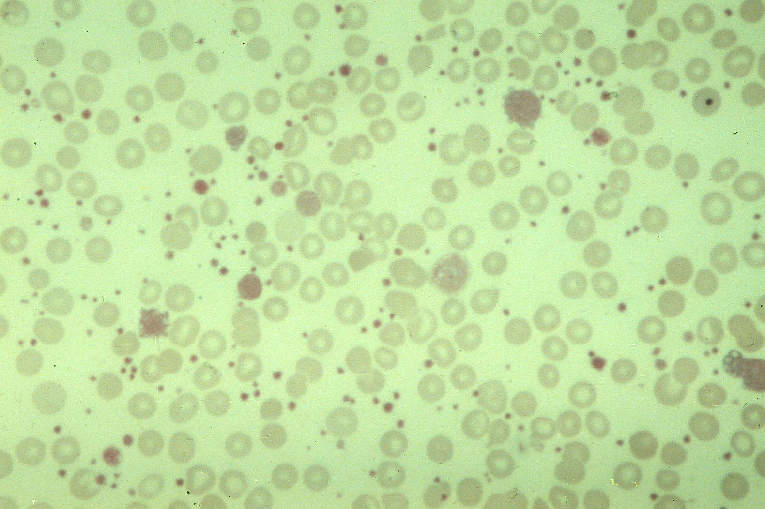
ET: Investigations

Slide 15
ET: Treatment
First question: Who to treat?
Older patient (>60 years) or patient with previous thrombotic episodes: treat
Young (<40 years), asymptomatic patient: May not require treatment
In between, asymptomatic: controversial

Slide 16
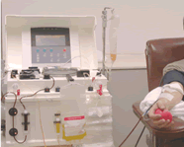
ET: Treatment
Control of platelet count reduces both thrombotic & hemorrhagic complications
Treatment options:
Hydroxyurea
Aspirin
Interferon-a
Anagrelide
Plateletpheresis

Slide 17
Primary Myelofibrosis (PMF)
Fibrosis in marrow (myelofibrosis)
Leukoerythroblastic reaction in blood:
- Nucleated RBCs, teardrop RBCs, immature granulocytes
Splenomegaly, often massive
Extramedullary haematopoiesis

Slide 18
PMF: Pathophysiology
Excessive production of growth factors by neoplastic megakaryocytes and other cells
Growth factors stimulate fibroblast proliferation and production of collagen
Fibroblasts are not part of malignant clone
One third of patient has previous PRV

Slide 19
PMF: Epidemiology
Predominantly older population
Male ≈ female (?)
Possible etiologic factors:
Ionizing radiation
Organic solvents (benzene, toluene)
No obvious underlying cause in most cases

Slide 20
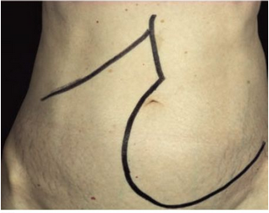
PMF: Clinical Features
Fatigue due to anemia
Abdominal discomfort, early satiety due to splenomegaly
Bleeding: Petechiae & purpura to haematemesis from gastroesophageal varices

Slide 21
PMF: Investigations
CBC & PBF
Anemia common
WBC variable: Leukocytosis in or Leukopenia in
Platelets: Decreased rarely increased with megakaryocyte fragments & giant platelets
Leukoerythroblastic reaction with teardrop RBCs:
Nucleated RBCs
Granulocyte precursors, including occasional blasts

Slide 22
MF: Investigations

Slide 23
MF: Investigations
Bone marrow:
Usually “dry tap” (no aspirate)
Fibrosis (may be subtle at first)
Cellularity: Initially increased (“cellular phase”); later decreased
Marked increase in megakaryocytes
Osteosclerosis may develop late

Slide 24
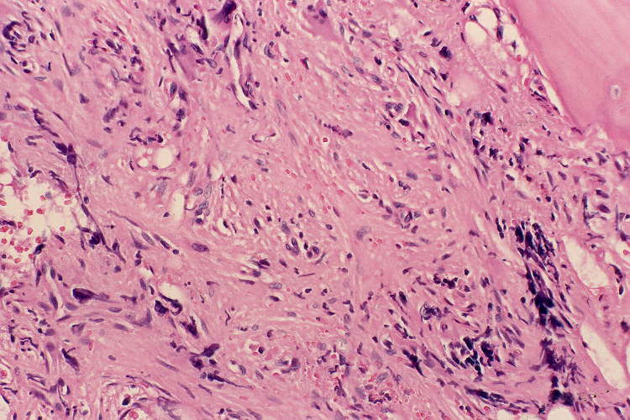
MF: Investigations

Slide 25
PMF: Differential Diagnosis
Other MPNs
Metastatic neoplasms: Carcinoma, lymphoma
Infections: Tuberculosis, fungi
Other granulomatous diseases
Hairy cell leukemia
Others

Slide 26
PMF: Clinical Course & Complication
Median survival ~ 5 years
Younger patients without anemia may have prolonged survival
Causes of death:
Infection
Acute leukemic transformation (5-20%)
Heart failure
Hemorrhage

Slide 27
PMF: Treatment
Treatment is usually palliative
Correct reversible factors: Iron, folate deficiencies
RBC & platelet transfusions as needed
Splenectomy (?)
Interferon-a
Stem cell transplant (experimental)

Slide 28
Summary: JAK2 in MPNs

Slide 29
Questions

Slide 30
Thank you

