Slide 1
LECTURE 39
Dr. REHAN

Slide 2
By the end of session, the student should able to:
Describe the conducting system of the heart.
Discuss arterial supply, venous drainage and nerve supply of the heart.
Describe the surface anatomy of the cardiac valves.
Correlate this knowledge to clinical conditions.

Slide 3
Conducting system of the heart
Consists of specialized cardiac muscle
Present in the sinoatrial node, the atrioventricular node, atrioventricular bundle and its right and left terminal branches, and subendocardial plexus of Purkinje fibers.

Slide 4
Conducting system of the heart
Sinoatrial Node
Located in the wall of the right atrium in the upper part of the sulcus terminalis
It is present right of the opening of the superior vena cava
Atrioventricular Node: placed on the lower part of the atrial septum just above the attachment of the septal cusp of the tricuspid valve

Slide 5
Conducting system of the heart
The atrioventricular bundle (bundle of His) descends through the fibrous skeleton of the heart.
The atrioventricular bundle descends behind the septal cusp of the tricuspid valve to reach the inferior border of the membranous part of the ventricular septum.
At the upper border of the muscular part of the septum, it divides into two branches, one for each ventricle.

Slide 6
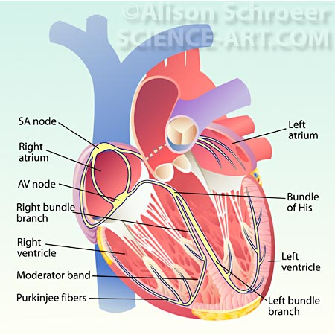
Conducting system of the heart
The right bundle branch (RBB) passes down on the right side of the ventricular septum to reach the moderator band.
From here, it is continuous with purkinje plexus.
The left bundle branch (LBB) pierces the septum and passes down on its left side beneath the endocardium.
Purkinje fibers: subendocardial plexus of conducting cells.

Slide 7
The Arterial Supply of the Heart
Right coronary artery
arises from the anterior aortic sinus of the ascending aorta and runs forward between the pulmonary trunk and the right auricle.
The left coronary artery supplies the major part of the heart including the greater part of the left atrium, left ventricle, and ventricular septum.
It arises from the left posterior aortic sinus of the ascending aorta and passes forward between the pulmonary trunk and the left auricle

Slide 8
Right coronary artery branches
Right conus artery
Anterior ventricular branch: two to three in number
Largest is known as marginal artery
Posterior ventricular branch
Posterior interventricular artery
Atrial branch

Slide 9
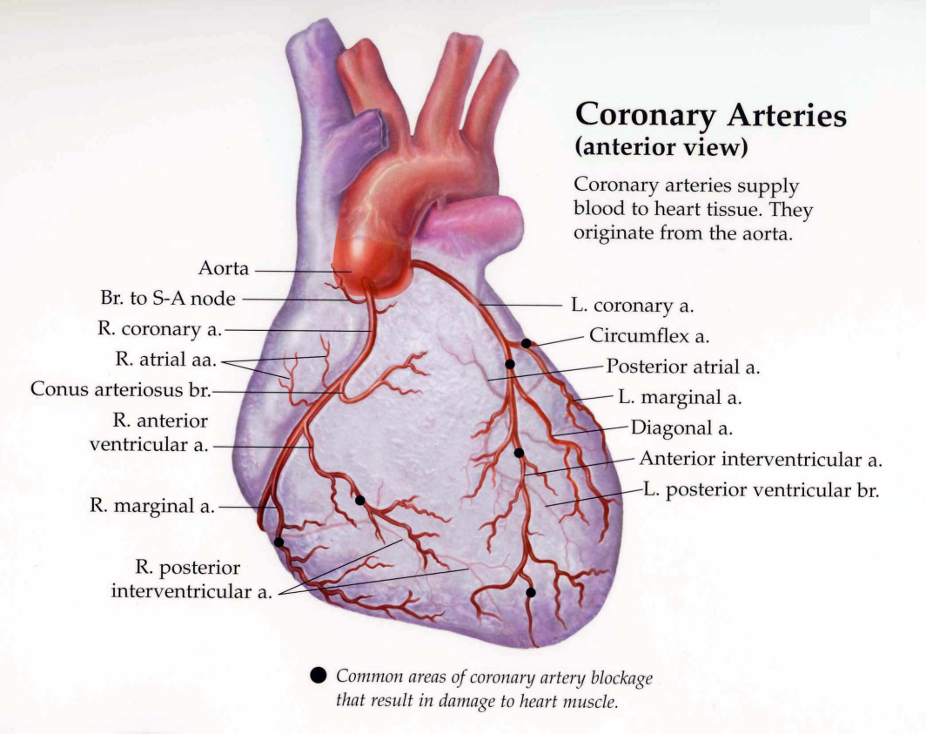
Left coronary artery
It enters the atrioventricular groove and divides into an anterior interventricular branch and a circumflex branch.
Some times left diagonal artery arises directly from left coronary artery
Left marginal artery is large branch of circumflex artery

Slide 10
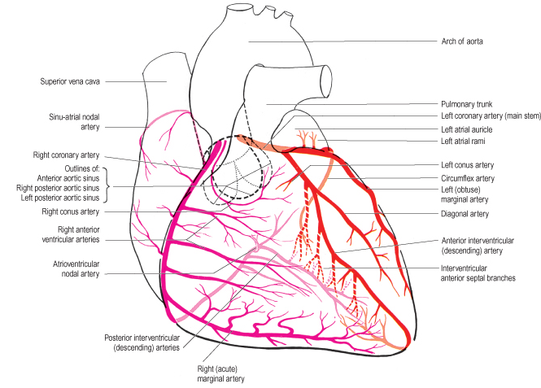
The Arterial Supply of the Heart

Slide 11
Venous drainage of heart
Most blood from the heart wall drains into the right atrium through the coronary sinus
Coronary sinus lies in the posterior part of the atrioventricular groove and is a continuation of the great cardiac vein.
The small and middle cardiac veins are tributaries of the coronary sinus.
Small amount is drained in the right atrium by the anterior cardiac vein

Slide 12
Innervation
Innervated by sympathetic and parasympathetic fibers of the autonomic nervous system via the cardiac plexuses situated below the arch of the aorta.
The sympathetic supply arises from the cervical and upper thoracic portions of the sympathetic trunks, and the parasympathetic supply comes from the vagus nerves.

Slide 13
Surface Anatomy of the Heart Valves
The tricuspid valve lies behind the right half of the sternum opposite the 4th intercostal space.
Mitral valve lies behind the left half of the sternum opposite the 4th costal cartilage.
Pulmonary valve lies behind the medial end of the third left costal cartilage and the adjoining part of the sternum.
Aortic valve lies behind the left half of the sternum opposite the 3rd intercostal space.

Slide 14
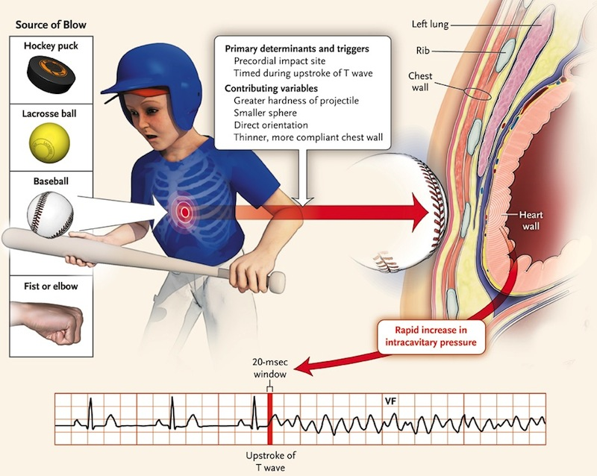
Clinical correlations
Arrhythmias: Failure of the bundle to conduct the normal impulses results in alteration in the rhythmic contraction of the ventricles
Commotio Cordis: results in ventricular fibrillation and sudden death
Caused by a blunt nonpenetrating blow to the anterior chest wall over the heart.
sudden blow is frequently produced by a baseball, baseball bat, lacrosse ball, or fist or elbow.
Ventricular fibrillation is most likely to occur if the blow occurs during the upstroke of the T wave

Slide 15
Clinical correlations
Coronary artery disease

Slide 16
Clinical correlations
In right dominance, the posterior interventricular artery is a large branch of the right coronary artery. Right dominance is present in most individuals (90%).
In left dominance, the posterior interventricular artery is a branch of the circumflex branch of the left coronary artery (10%).

Slide 17
Clinical correlations
Carotid angiogram: a small catheter introduced through the skin into an artery in either the groin or the arm.
Assistance of a fluoroscope (a special x-ray viewing instrument), the catheter is then advanced to the opening of the coronary arteries (the blood vessels supplying blood to the heart).
The images that are produced are called the angiogram.

Slide 18
Clinical correlations
The tricuspid valve is best heard over the right half of the lower end of the body of the sternum.
The mitral valve is best heard over the apex beat, that is, at the level of the fifth left intercostal space, 3.5 in. (9 cm) from the midline
The pulmonary valve is heard with least interference over the medial end of the second left intercostal space
The aortic valve is best heard over the medial end of the second right intercostal space

Slide 19
Summary
Conducting system of heart
Arterial supply of heart
Venous drainage
Innervation
Clinical correlations

Slide 20
References
Clinical Anatomy by Regions: R.S. Snell, 9th ed.
Gray’s Anatomy for students, 2nd ed.
http://www.medicinenet.com/coronary_angiogram/article.htm

